Slide 1
Treap刷题
数据结构与算法365特训营

Slide 2
Treap刷题
本次课内容
POJ3481
BZOJ3224
POJ1442
HDU4585

Slide 3
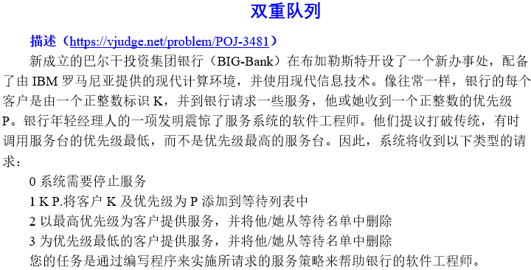
Treap刷题
POJ3481

Slide 4
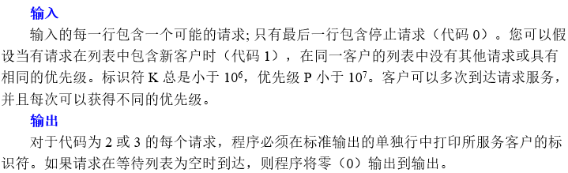
Treap刷题
POJ3481

Slide 5

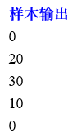
Treap刷题
POJ3481

Slide 6
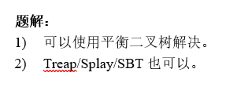
Treap刷题
POJ3481

Slide 7
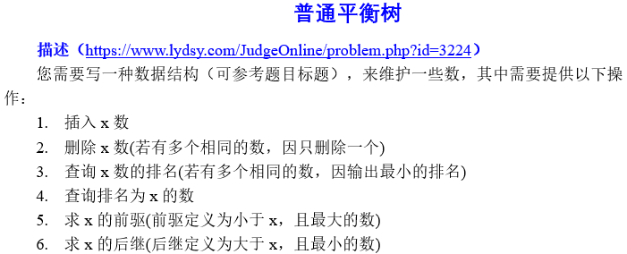
Treap刷题
BZOJ3224

Slide 8
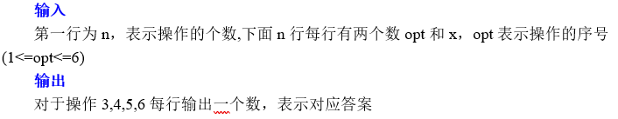
Treap刷题
BZOJ3224

Slide 9
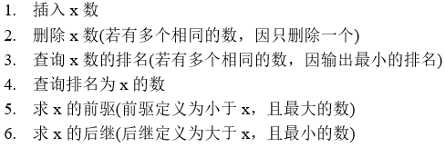
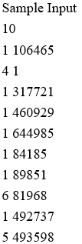
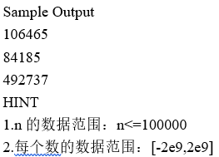
Treap刷题
BZOJ3224

Slide 10

Treap刷题
BZOJ3224

Slide 11
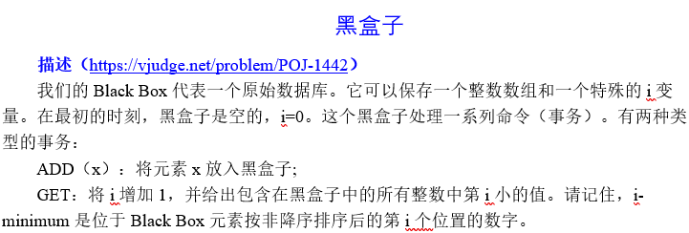
Treap刷题
POJ1442

Slide 12
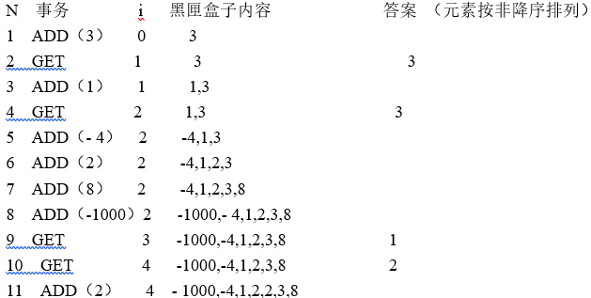
Treap刷题
POJ1442

Slide 13
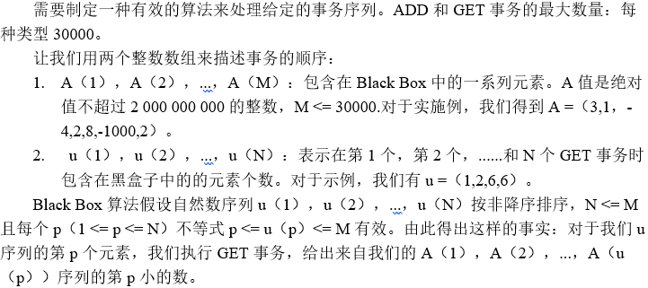
Treap刷题
POJ1442

Slide 14
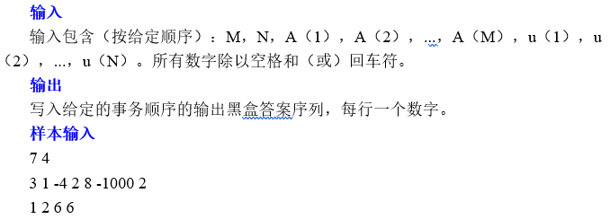

Treap刷题
POJ1442

Slide 15

Treap刷题
POJ1442

Slide 16
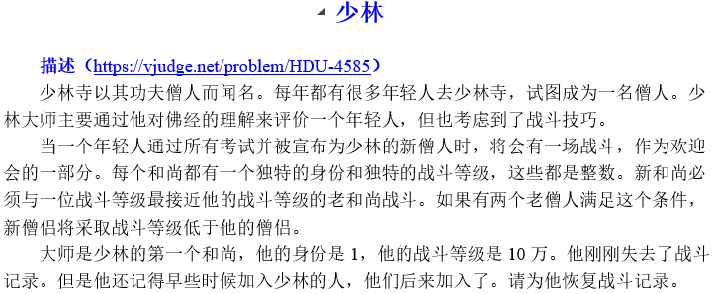
Treap刷题
HDU4585

Slide 17
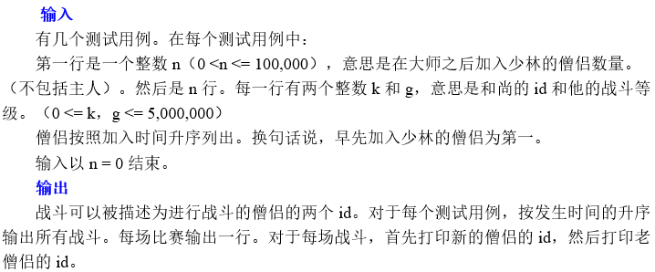
Treap刷题
HDU4585

Slide 18
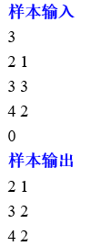
Treap刷题
HDU4585

Slide 19
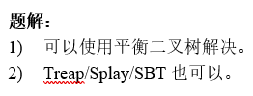
Treap刷题
HDU4585

Slide 20
作业
POJ3481
BZOJ3224
POJ1442
HDU4585

