Slide 1
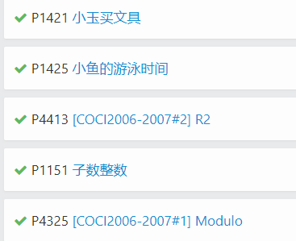
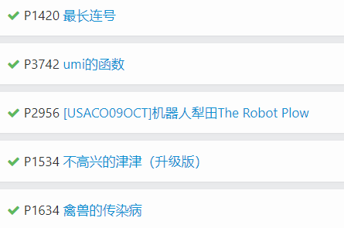
作业
https://www.luogu.org/problemnew/lists?name=&orderitem=difficulty&tag=&content=0&type=
以下任选2道题：

